Slide 1




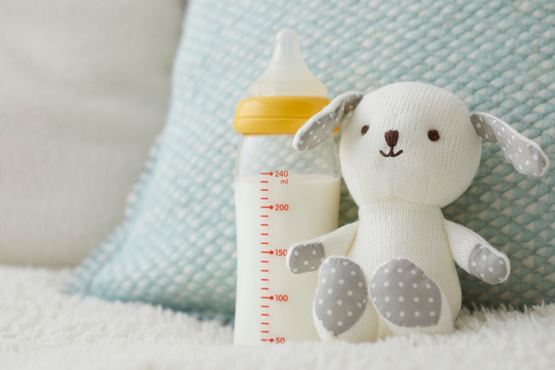

[START DATE - END DATE]
You can promote life in your community by giving towards LifePlan’s fight for the unborn and support for hurting mothers and families.
Pick up a baby bottle
[PICK UP LOCATION]
Fill your bottle
Fill with coins, cash, or checks
Return your bottle
www.lifeplan.org
[RETURN LOCATION]

