Slide 1


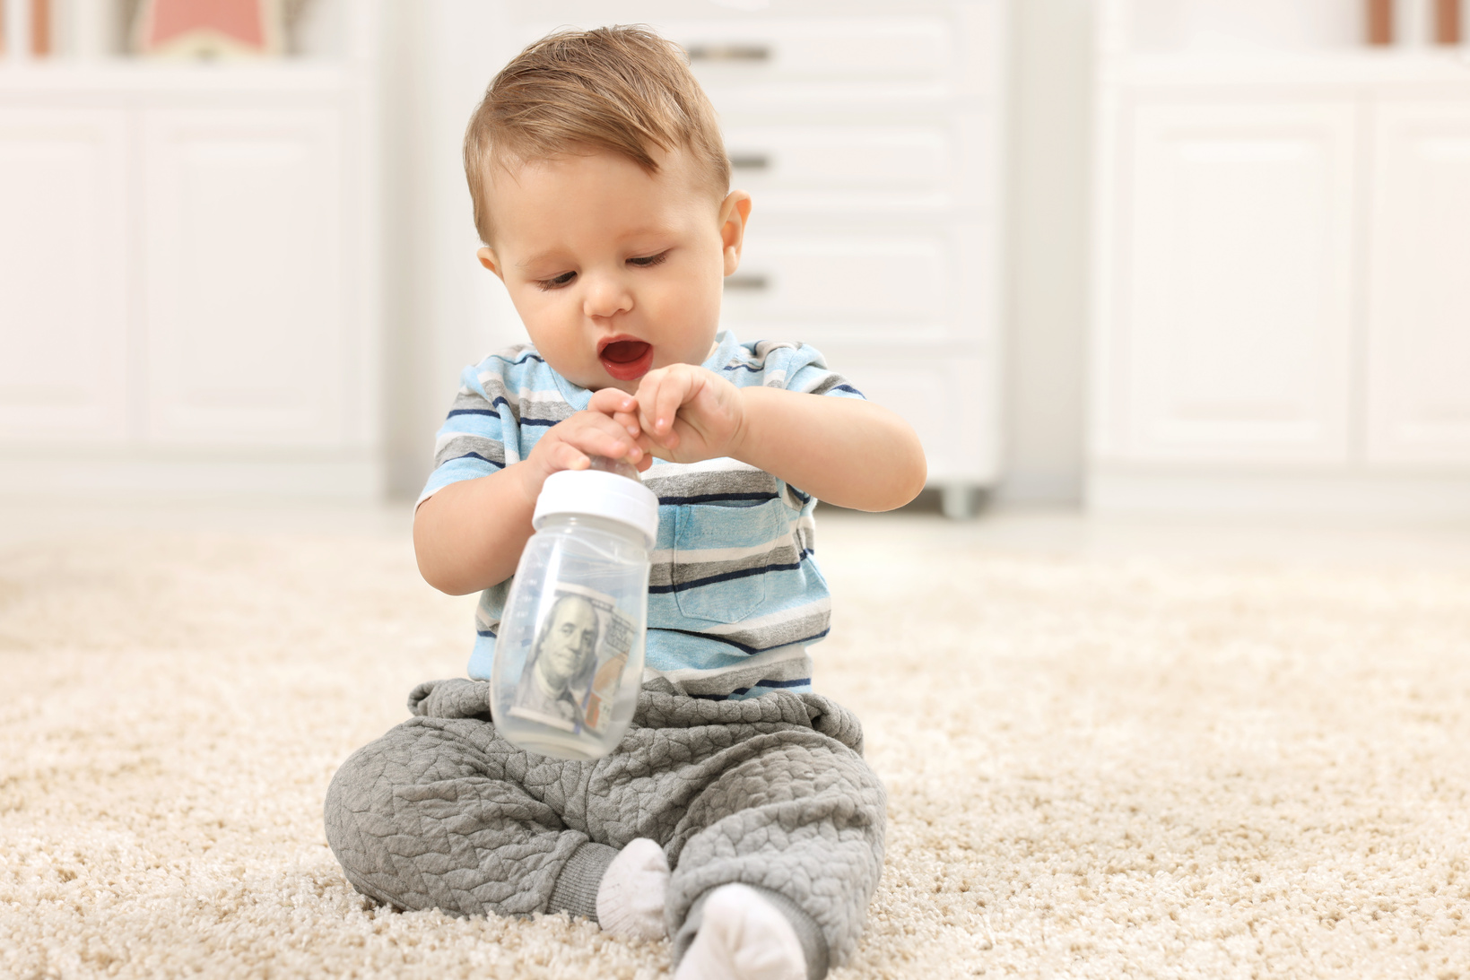


[START DATE - END DATE]
Be part of something extraordinary this Mother’s Day - Father’s Day! Donate to support LifePlan in helping people choose life and live hope-filled lives.
Pick up a baby bottle
Fill your bottle
Return your bottle
[PICK UP LOCATION]
Fill with coins, cash, or checks.
[DROP OFF LOCATION]

