Slide 1



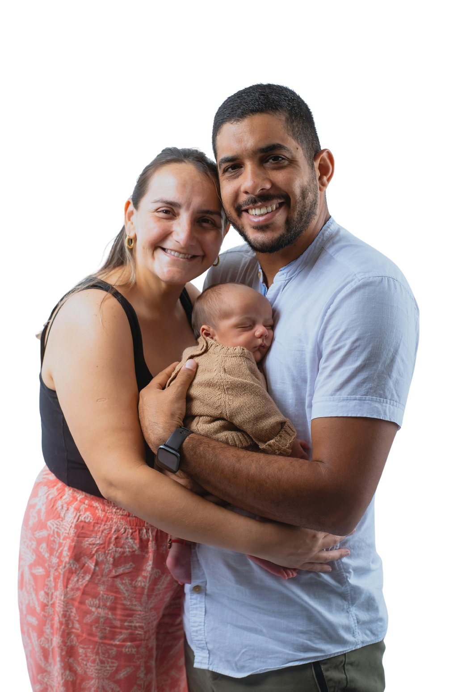
Change for
[Start date - End date]
L
IFE
Grab a bottle
You can promote life in your community by giving towards LifePlan’s fight for the unborn and support for hurting
mothers and families.
[Pick-Up Location]
Fill your bottle
Fill with coins, cash, or checks
Return your bottle
[Drop Off Location]

