Slide 1
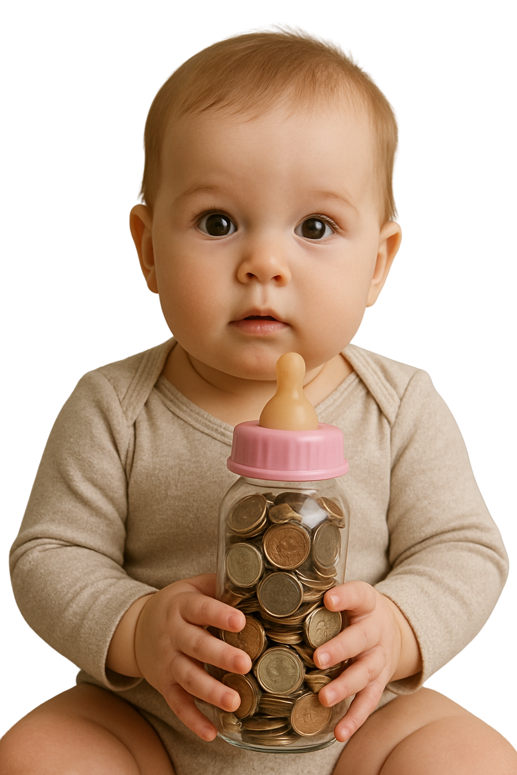


Grab a bottle
[Pick-Up Location]
Fill your bottle
You can promote life in your community by giving towards LifePlan’s fight for the unborn and support for hurting mothers and families.
Fill with coins, cash, or checks
Return your bottle
[Drop Off Location]
[Start date - End date]

