Slide 1




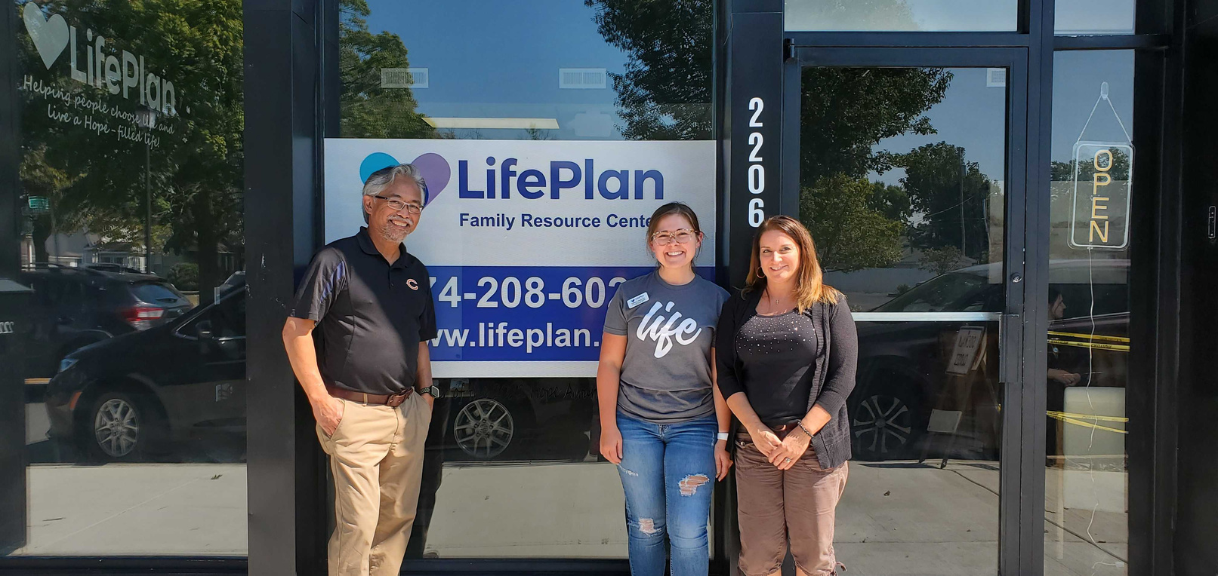
This January, for Sanctity of Human Life Month, you can promote life in our community by giving towards LifePlan’s fight for the unborn and support for hurting mothers and families.
Pick up a baby bottle
Fill your bottle
Return your bottle
[PICK UP LOCATION]
Fill with coins, cash, or checks.
[DROP OFF LOCATION]

