Slide 1










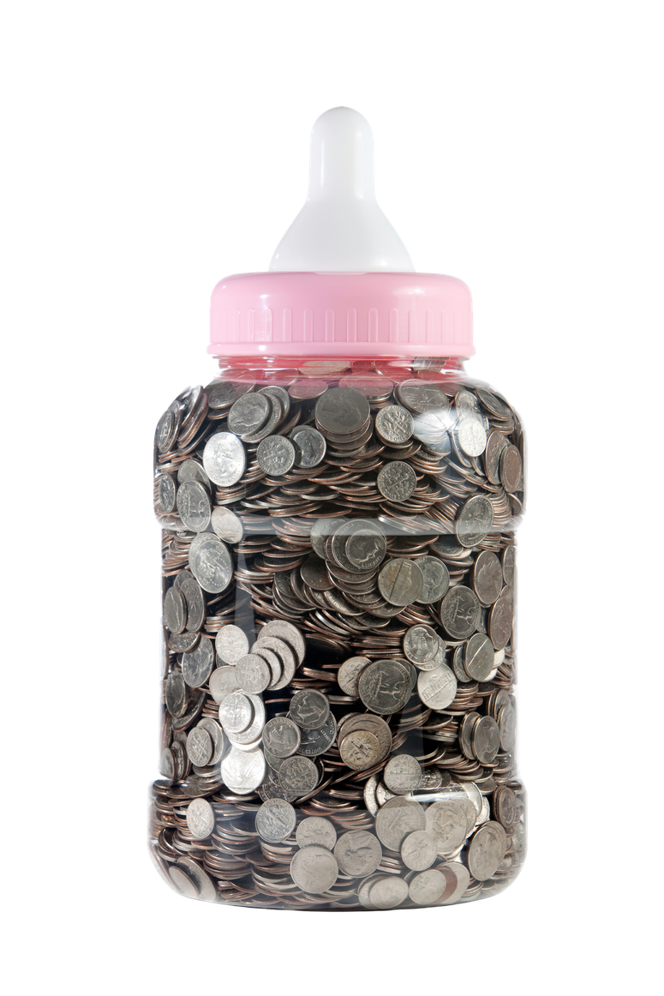




REMEMBER!
Collect coins, cash, and checks at home
Fill the Bottle, Help a Family
Bring them to church and drop them in our giant baby bottle
Your coins help buy diapers, car seats, clothes, and more for moms and babies.

