Slide 1
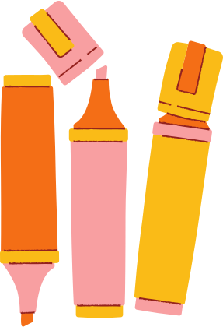
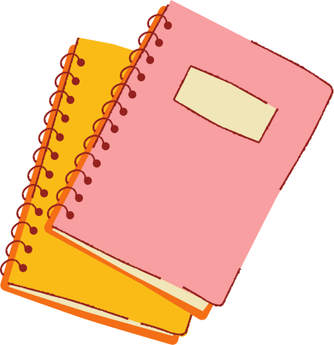
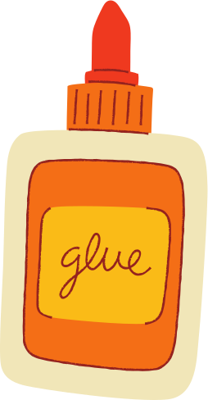

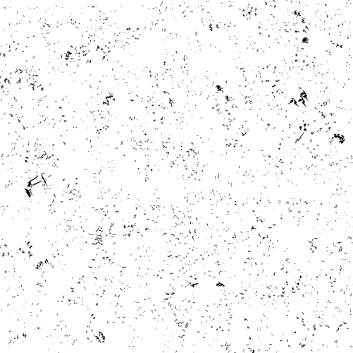



Your spare change helps LifePlan equip students to make wise, informed decisions.
SCHOOL
IS
BACK
Fill a baby bottle with checks, loose change, or cash.
TOGETHER LET’S MAKE A CHANGE FOR LIFE!
Return your bottle to your group leader, or any LifePlan location.
Donate anytime at www.lifeplan.org/changeforlife

