Slide 1




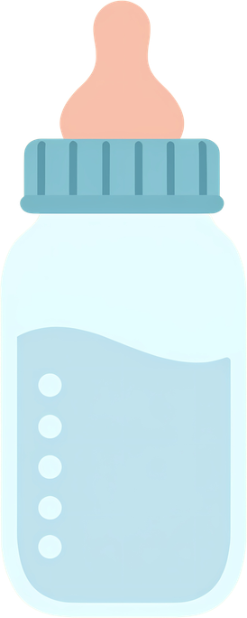

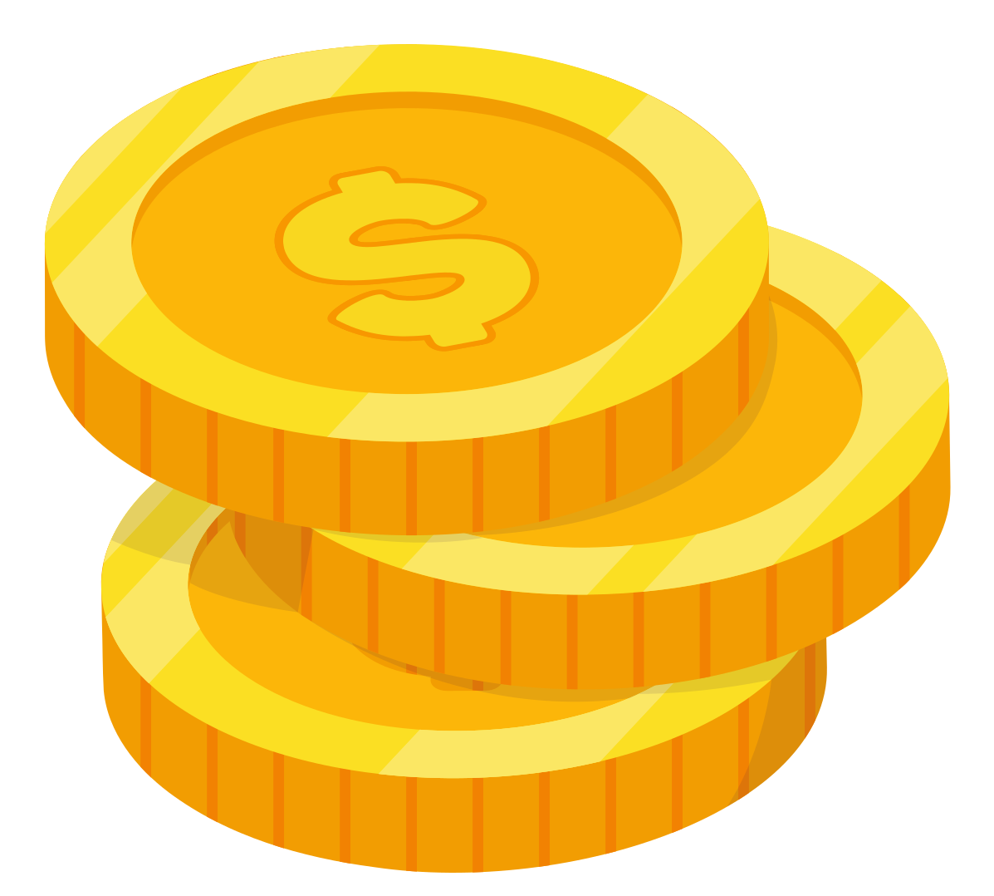

Fill a baby bottle with checks, loose change, or cash.
LESSONS THAT LAST A LIFETIME
Return your bottle to your group leader, or any LifePlan location.
Your spare change helps LifePlan equip students to make wise, informed decisions.
Donate anytime at
www.lifeplan.org/changeforlife

