Slide 1

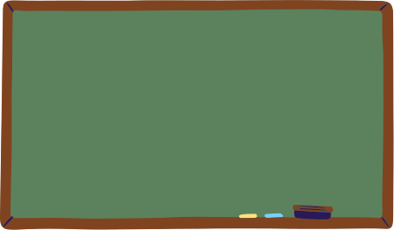

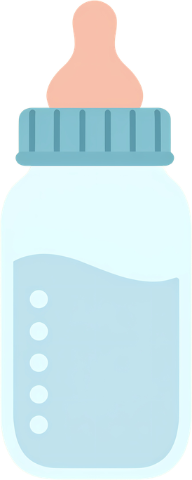


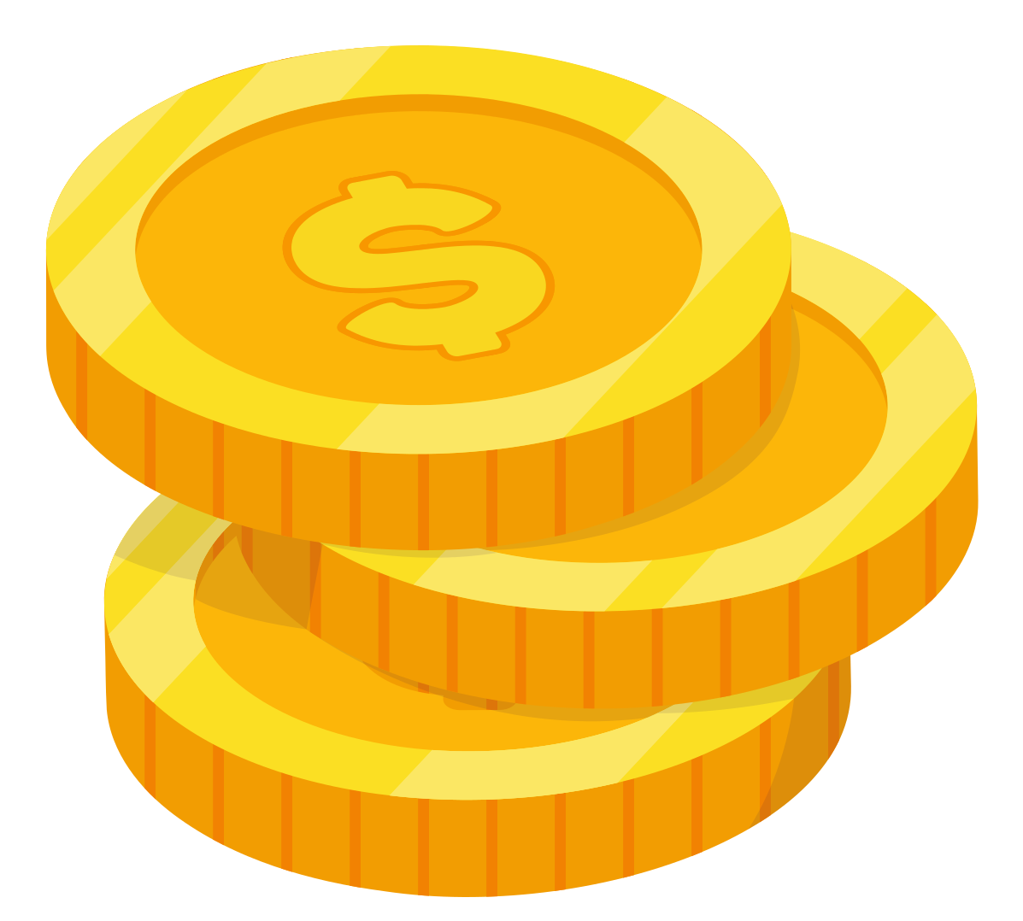


SMALL CHANGE,
Fill a baby bottle with checks, loose change, or cash.
LASTING IMPACT
Return your bottle to your group leader, or any LifePlan location.
TOGETHER LET’S MAKE A CHANGE FOR LIFE!
Donate anytime on our website
Your spare change helps LifePlan equip students to make wise, informed decisions.

